Slide 1
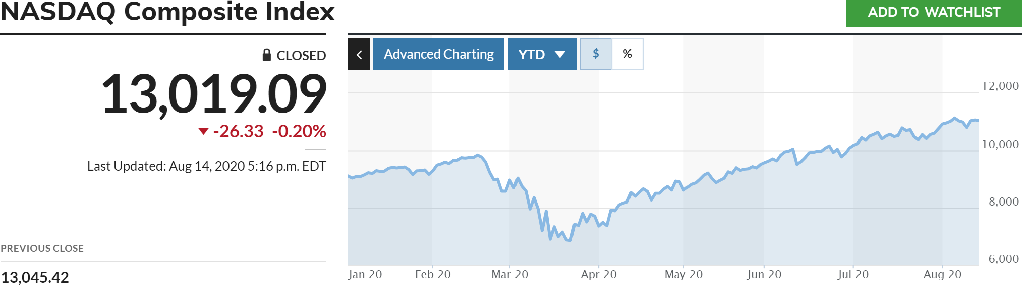
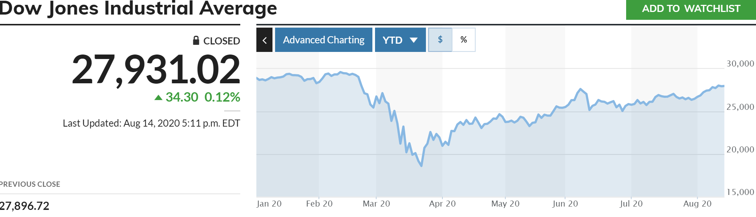
Stock Price Prediction using Machine Learning: Can we?
Purpose of this project was to assess how well ML can predict magnitude and direction of the stock: it’s price

Slide 2

The Team
and I
Me
myself

Slide 3
About Me
Levi DeRoche
My moto: “If you are not learning new things you are being left behind”
I currently work as a Managing Consultant at a small firm based in Chicago. I have approximately 20 years of experience.
I have extensive background in data, SQL, SAS and Power BI. I also had a pretty descent exposure to VBA, and several other data-oriented tools/languages.
MBA with Finance concentration.
Took the data science bootcamp because open source is rapidly transforming this space and I wanted to remain current/relevant.

Slide 4
Approach: Efficiency
Efficiency & Reliability
Phase 1: Build LSTM model
Research instead of excessive coding
Since I am a one-man shop, I turned to trusted sources like medium, Yahoo Finance and New York Times to get a sense of the prevailing sentiment of the various ML algorithms as it relates to Stock price predictions
Two things stood out:
Questionable approaches to stock price predictions
Single feature input was the most common flaw I found
LSTM – RNN seem to be the approach showing most promise
RNN Advantages: Great at modeling sequence of data
RNN Disadvantage: Training is a challenge
LSTM – Addresses some of the native RNN shortcomings and expands aplicability
Build LSTM ML model
Use multiple feature: Open, High, Low & Volume
Tools:
Matplotlib
Sklearn.model_selection
Sklearn.prepocessing
Tensorflow.keras
Pandas
Numpy
Pandas_datareader (a new favorite)
Use date parameter to split data: time-series
Helps assess output

Slide 5
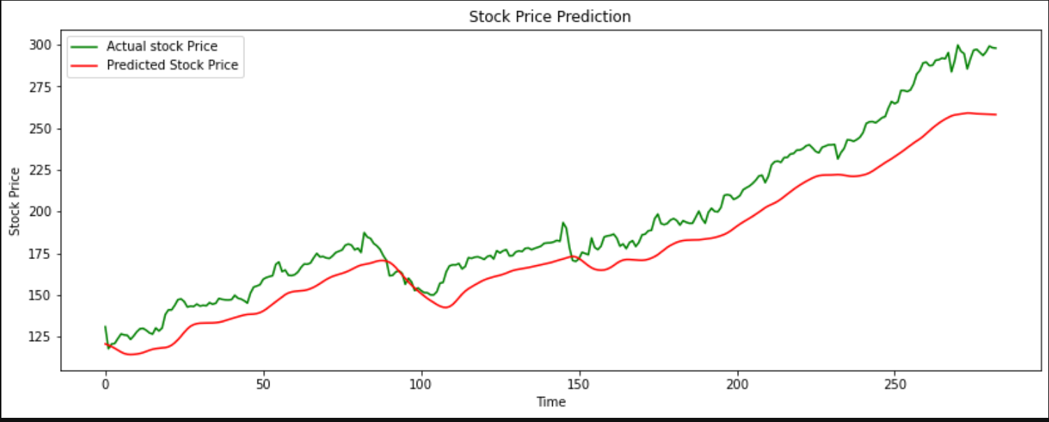
Summary Findings: AAPL Charts

Slide 6
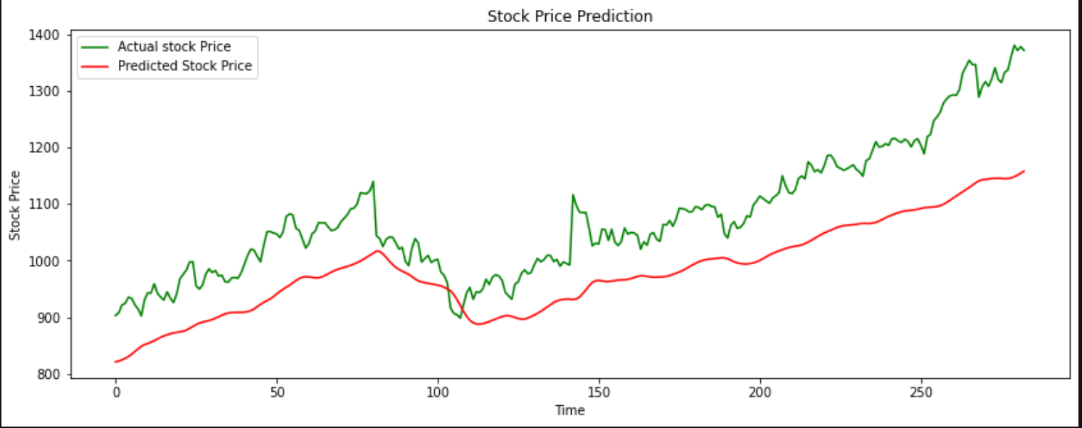
Summary Findings: GOOG Charts

Slide 7
Overall: ML Stock Price Predictors
LSTM - RNN
Challenges:
Very good at predicting trend- direction
Requires significant optimization to improve materially on magnitude: price
Found to more accurate than single feature input models
This project time, although it is usually data
Additional Resources

Slide 8
What’s Next: Continue to Learn and Build
LSTM – RNN Model
Enhancements
Continue Optimizing the model
Consider an ensemble approach if continued efforts falls short
Found to more accurate than single feature input models
Add web user interface
Integrate comparsm features from features from Stocker()
Shows potential financial impact of deviation from actual stock prices
Optimize to leverage cuda GPUs when present
Portfolio capabilities (multiple stock analysis

